Slide 1
Mathematics in the Redesigned SAT
Examining Ways to Improve
Student Achievement
Dr. Adrian Talley, DoDEA Principal Deputy Director & Associate Director for Education
Dr. Sarah Koebley, Mathematics ISS
Ms. Faatimah Muhammad, Gifted Education, Advanced Placement, and AVID ISS

Slide 2
Welcome and Introductions
Dr. Adrian Talley,
DoDEA Principal Deputy Director & Associate Director for Education

Slide 3
Learner Outcomes
By the end of this webinar, we will have:
Learned about the changes in mathematics planned for the SAT
Examined College Board test specifications to analyze how to add rigor to teacher-written assessments
Learned about math instructional practices that support increased student achievement

Slide 4
Agenda: At-A-Glance
Time | Topic | Presenters
5 min | Welcome, Introductions, Webinar Interface, and Norms | Dr. Adrian Talley Ms. Dawn Corley
5 min | Introductions to the Math Changes in the SAT | Dr. Adrian Talley
5 min | Three Key Changes in SAT Mathematics | Dr. Sarah Koebley
12 min | Key Change #1: Math Content Group Engagement: Poll | Dr. Sarah Koebley Ms. Faatimah Muhammad
12 min | Key Change #2: Context Group Engagement: Discussion | Ms. Faatimah Muhammad Ms. Dawn Corley
12 min | Key Change #3: Calculator Use and Scoring Group Engagement: Padlet Wall | Dr. Sarah Koebley Ms. Dawn Corley
5 min | The Impact of Math SAT Changes on Classroom Instruction: Rigor | Dr. Sarah Koebley Ms. Faatimah Muhammad Dr. Adrian Talley
20 min | Translating SAT Changes to Classroom Instruction – Video Analysis | Dr. Sarah Koebley
15 min | Closing, Summary, Questions Exit Ticket | All

Slide 5
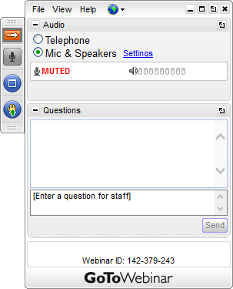
Webinar Norms
If you have a question, type it in the Question Pane.
If the organizer or presenter has a question to the participants, submit your response in the Question Pane.
If you need technical support, type the request in the Question Pane.
A response from Technical Support will be provided.
To request audio, click the “Raise Hand.”

Slide 6
Why change the SAT?
“The redesigned SAT will test the few things that research shows matter most for college readiness and success.”
– College Board
“Because a test alone can’t change student outcomes, assessments such as the SAT must be integrated with rigorous classroom instruction and, through their results, propel students to greater opportunities. The redesigned SAT will reward productive use of classroom time and a focus on rigorous course work.”
– College Board
Impacts THIS year’s sophomores (changes implemented in Spring 2016)

Slide 7
Overall Claim for Mathematics SAT
Students have fluency with, understanding of, and the ability to apply the mathematical concepts, skills and practices that are most strongly prerequisite and central to their ability to progress through a range of college courses, career training, and career opportunities.

Slide 8
What do these mathematics changes mean to you and our students?
How do these changes affect our students?
How do these changes impact math practices in the classroom?
What support is needed to ensure success?

Slide 9
3 Key Changes
in SAT Mathematics
MATH CONTENT
CONTEXT
CALCULATOR USE AND SCORING

Slide 10
3 Key Changes in Redesigned SAT Math Test
Focus on math content that matters the most
Problems grounded in real-world contexts
Scoring of the test and use of calculators

Slide 11
Key Change #1: Math Content
In-depth tasks from essential areas of mathematics:
Focus on Math that Matters Most
Heart of Algebra
Problem Solving and Data Analysis
Passport to Advanced Math
Additional Topics

Slide 12
Source: The Redesigned SAT, College Board, 2014

Slide 13
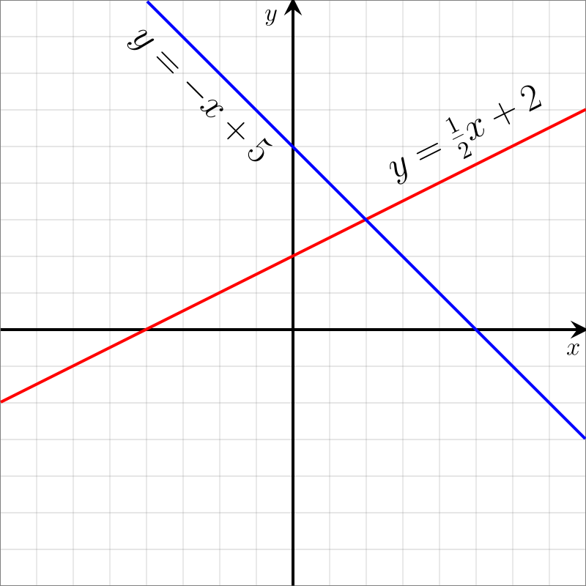
Heart of Algebra
Focuses on the mastery of linear equations and systems, which helps students develop key powers of abstraction
Analyzing and fluently solving equations and systems of equations
Creating expressions, equations, and inequalities to represent relationships between quantities and to solve problems
Rearranging and interpreting formulas

Slide 14
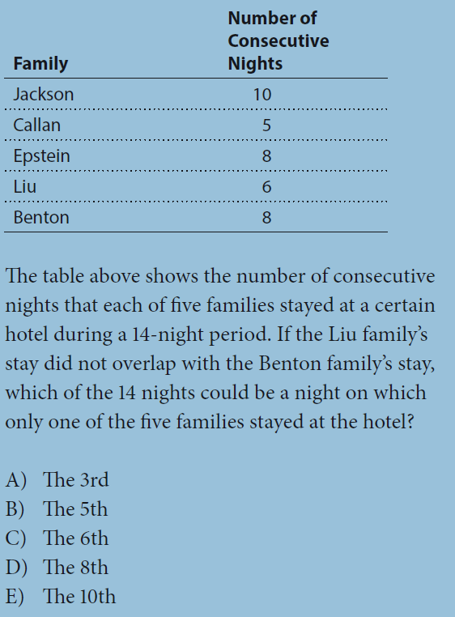
Focus on Applied Reasoning Skills
Current SAT
Redesigned SAT
Looking for and making use of algebraic structure
Disconnected from math reasoning skills

Slide 15
Fluency AND Understanding

Slide 16
Group Engagement: Poll
Which new problem features found in the redesigned SAT did this problem display?
When the poll launches, select your top two choices!

Slide 17
Fluency AND Understanding
SOLUTION:

Slide 18
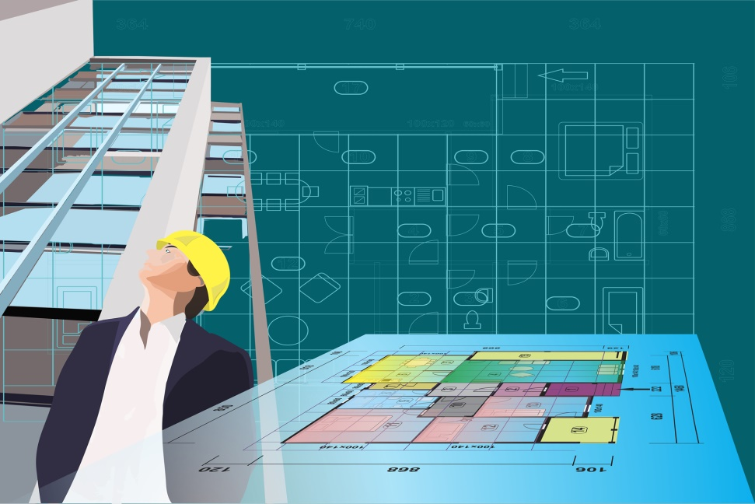
Key Change #2: Context
Solve multi-step application problems
Solve problems in science, social science, career scenarios, and other real-life contexts
Interpret and synthesize data
Ratios, rates, proportional relationships (unit rate)
Outliers and measures of center
Solve multiple problems from one data set
Problems Grounded in
Real-World Contexts

Slide 19
Problem Solving and Data Analysis
Represent and analyze relationships
using rates and proportional reasoning to solve problems in science, social science, and career contexts
Describe relationships shown graphically
Summarize qualitative and quantitative data

Slide 20
Applications – Science and Social Studies
A researcher places two colonies of bacteria into two petri dishes that each have area 10 square centimeters. After the initial placement of the bacteria (t = 0), the researcher measures and records the area covered by the bacteria in each dish every ten minutes. The data for each dish were fit by a smooth curve, as show, where each curve represents the area of a dish covered by bacteria as a function of time, in hours.
Which of the following is a correct statement about the data above?
At time t = 0, both dishes are 100% covered by bacteria.
At time t = 0, bacteria covers 10% of Dish 1 and 20% of Dish 2.
At time t = 0, Dish 2 is covered with 50% more bacteria than Dish 1.
For the first hour, the area covered in Dish 2 is increasing at a higher average rate than the area covered in Dish 1.

Slide 21
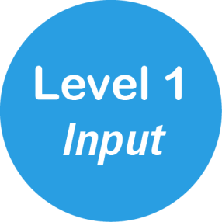
Data Analysis - Levels of Rigor
At one hour, how many square centimeters are covered in Dish 1?
Explain the mathematical relationship between the variables “area covered” and “time.”
If this data represents disease-causing bacteria in a water source, what decisions would you recommend that local officials make about water treatment?

Slide 22
Passport to Advanced Math
More complex equations, their meaning, and the manipulation they require
Creating, analyzing, and fluently solving quadratic and higher-order equations

Slide 23
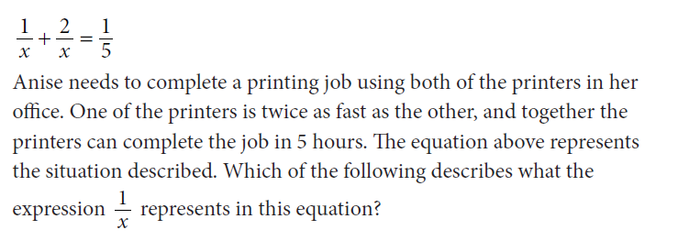
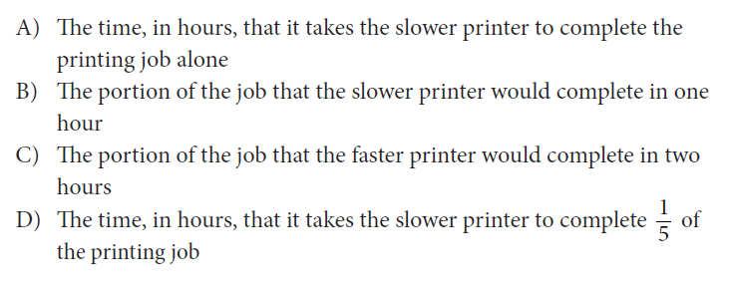
Advanced Math Example
How does this problem demonstrate the new emphasis on fluency AND conceptual understanding?

Slide 24
Group Engagement: Padlet
Click the link, http://padlet.com/dawn_corley/math
Password: math
Read the problem on the Padlet Wall at the link above. In your groups, discuss how you would solve it. Then write 2 words on the Padlet Wall to answer the question below:
How does this problem demonstrate the new SAT’s emphasis on fluency AND conceptual understanding?

Slide 25
Advanced Math
Solution: ?
Requires students to interpret/decipher an expression/equation that models a real world situation
Students interpret the expression without a calculator in terms of its context

Slide 26
Key Change #3: Calculator Use and Scoring
Designed to assess students’ understanding of mathematical concepts, rather than their ability to “plug and chug”
No-calculator portion
assess fluencies valued by postsecondary instructors
conceptual questions for which a calculator will not be helpful
Calculator portion
more complex modeling and reasoning questions to allow students to make computations more efficiently
questions in which the calculator could be a deterrent to expedience, thus assessing appropriate use of tools
students who make use of structure or their ability to reason will reach the solution more rapidly than students who get bogged down using a calculator

Slide 27
Get the Facts: Calculator Use and Scoring
No Penalty for Wrong Answers
Students will earn:
One point for each correct answer.
Zero points for unanswered items.
Zero points for wrong answers.
200 to 800 for Math; Scale ranging from 400 to 1600
Sub-scores for every test, providing added insight for key stakeholders to interpret scores
More time (+10 min), 3 more items (57 items)

Slide 28
The Impact of
Math SAT Changes on
Classroom Instruction

Slide 29
How do changes in the SAT impact mathematics practices in the classroom?
Time | Instructions | Resources Needed
3 minutes | Read the “Introduction and Background..” BEFORE watching the video. | Handout 1
7 minutes | View the video. Complete the “Features of the Redesigned SAT Mathematics Test” template while viewing. | Video URL Handout 2
10 minutes | Discuss the question: (in pairs, then in whole group) | What evidence do you see in the “DVD Plan” lesson of the new SAT features shared today?
20 minutes Total

Slide 30
Rigor in the SAT
SAT tasks cover all mathematical practices included in the
Common Core Standards for Mathematical Practice.
Problem solving requires students to make sense of problems and persevere to solve them, a skill highly rated by postsecondary instructors (Conley et al., Reaching the Goal, 2011).
Modeling stresses applications characteristic of the entire postsecondary curriculum.

Slide 31
Rigor in the SAT (Continued)
Students will be asked throughout high school, college, and in their careers to make choices about which tools to use to solve problems.
Mathematical structure is fundamental to algebra and to other more advanced mathematics.

Slide 32
Does anyone have any questions?

Slide 33
District Collaborative Work
All resources for this session are located in the folder,
“After the Webinar” in Schoology.
Instructions | Resources
Use Handout 3, “Test Specifications for the Redesigned SAT Exploration Guide” to investigate further the changes in the SAT. | Handout 3
Jigsaw the material in the Test Specifications for the Redesigned SAT booklet. | SAT Booklet
Share out as a group. | Each other!
1.5 Hours Minimum Recommended
Facilitator: complete the Group Exit Ticket at the conclusion of your share-out.

